Slide 2
The Changing Face of Technology
Prayer.
Purpose of Parent Equipping.

Slide 3
Ephesians 4:11–12
11 And He Himself gave some [to be] apostles, some prophets, some evangelists, and some pastors and teachers, 12 for the equipping of the saints for the work of ministry, for the edifying of the body of Christ.

Slide 4
Youth Group Mission Statement
The youth group at Harvest Baptist Church exists to assist parents in the discipling of their teenagers.

Slide 5
The Changing Face of Technology
Prayer.
Purpose of Parent Equipping.
Four Things Youth Workers Would Tell Parents About Teenagers, Social Media, and Technology.

Slide 6
Four Things Youth Workers Would Tell Parents About Teenagers, Social Media, and Technology.
Behind your back, kids will tell their youth pastor that they resist technological restrictions at home, but they know their parents are doing the wise thing.
If your son has unfettered access to the internet, he is almost definitely looking at pornography.
If your son or daughter has SnapChat, they are being exposed to awful things or being enabled to do awful things.
Your child may not go looking for trouble but it will come looking for them.

Slide 7
The Changing Face of Technology
Prayer.
Purpose of Parent Equipping.
Four Things Youth Workers Would Tell Parents About Teenagers, Social Media, and Technology.
Recommended Resources.
Books

Slide 11
The Changing Face of Technology
Prayer.
Purpose of Parent Equipping.
Four Things Youth Workers Would Tell Parents About Teenagers, Social Media, and Technology.
Recommended Resources.
Books
Covenant Eyes

Slide 12
The Changing Face of Technology
Prayer.
Purpose of Parent Equipping.
Four Things Youth Workers Would Tell Parents About Teenagers, Social Media, and Technology.
Recommended Resources.
Books
Covenant Eyes
Disney’s Circle- strongest recommendation
Notes:
Issue with protecting our families: either we have device protection or network protection. Disney is the only software I’m aware of that does both and comes highly recommende.

Slide 13
The Changing Face of Technology
Prayer.
Purpose of Parent Equipping.
Four Things Youth Workers Would Tell Parents About Teenagers, Social Media, and Technology.
Recommended Resources.
The Tech-Wise Family
Covenant Eyes
Disney’s Circle- strongest recommendation
15 Apps Parents Should Know About.

Slide 14
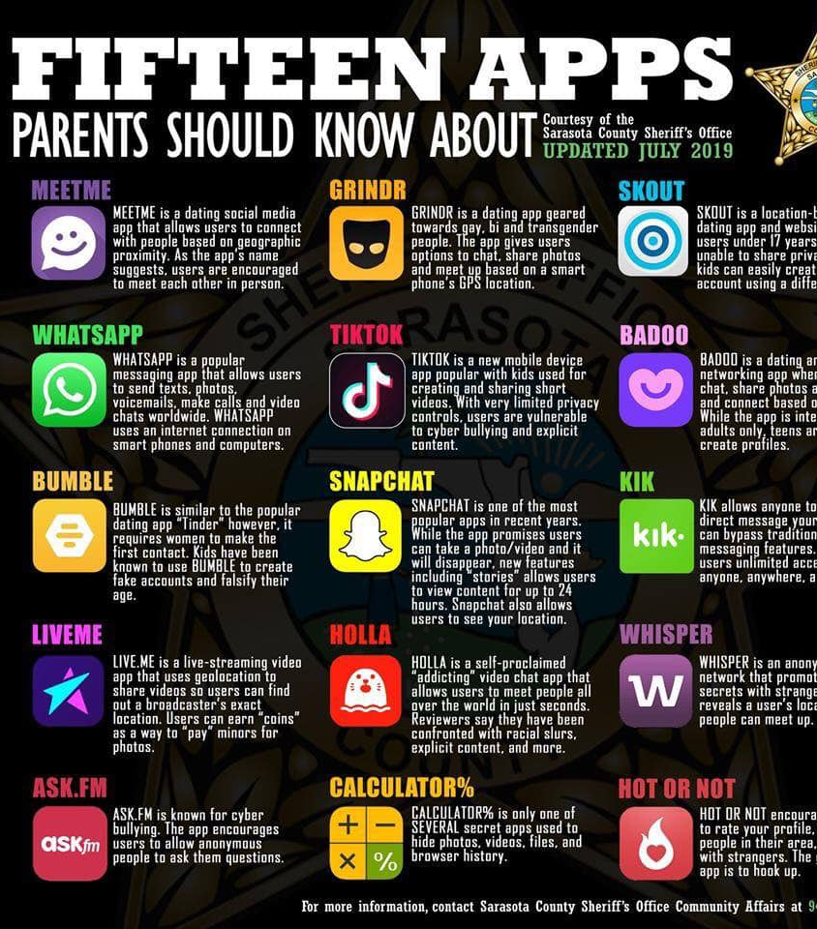
15 Apps Parents Should Know About
See Handout for detailed description of each.
Of particular interest: SnapChat, TikTok, Calculator%
Note on WhatsApp: used a lot by international travelers and people from other countries. Versatile platform that works globally.

